Slide 1

Trends in Job Density
By Chad Shearer, Joanne Kim, and Jennifer Vey

Slide 2
[Intro text]
TK

Slide 3

Average versus perceived density of jobs under three scenarios
All the findings on job density here refer to the weighted or “perceived” density of jobs in metro areas. Perceived job density measures the job density of the place in which the average job is located, revealing the average number of jobs in the vicinity of each job. Therefore, perceived job density provides a better approximation of how dense a metro area feels and how compactly its jobs are concentrated.
1 mi
1 mi
Ex 1. Low perceived density
Standard density: 1 job/mi²
Perceived density: 1 job/mi²
Ex 2. Medium perceived density
Standard density: 1 job/mi²
Perceived density: 2.3 jobs/mi²
Ex 3. High perceived density
Standard density: 1 job/mi²
Perceived density: 9 jobs/mi²
Calculating expected versus actual change in local-area job density
To understand how and why job density has changed, we examine both the actual trends as well as counterfactual or “expected” trends in perceived job density. Expected changes are estimated using a shift-share analysis as described in the figure, indicating the change in a metro area’s job density predicted from its job growth alone.
This year’s
actual job density
This year’s expected job density
Actual density last year
Expected change in density
Unexpected change in density
Actual density this year
Expected change in density due to metro area job growth
Expected additional change in density due to job growth within each sector
Job density trends on average
Job density trends across metro areas
Job density trends in each metro area

Slide 4
[META HEADER 1: Job density on average] Metropolitan America saw a large increase in job density from 2004 to 2015
Figure 1(A)
ANNOTATION:
The perceived job density of all 94 large metro areas taken together increased nearly 30 percent, indicating job growth was highly concentrated in dense urban areas from 2004 to 2015.
During the Great Recession from 2007 to 2009, the average perceived job density increased more than 10 percent as suburban and exurban areas shed their jobs faster than denser urban areas. Perceived job density has steadily increased since 2009.
(Keep scrolling)

Slide 5
[META HEADER 1: Job density on average] Metropolitan America saw a large increase in job density from 2004 to 2015
Figure 1(B)
ANNOTATION:
These overall trends in job density however were greatly influenced by a set of four extremely dense metro areas – New York, Chicago, San Francisco, and Seattle. These four metro areas saw an even greater increase in job density, accounting for about 90 percent of the increase in job density seen among all 94 large metro areas during this period.
(Keep scrolling)

Slide 6
[META HEADER 1: Job density on average] Metropolitan America saw a large increase in job density from 2004 to 2015
Figure 1(C)
ANNOTATION:
In contrast to job density trends in the four extremely dense metro areas, job density in the other 90 large metro areas increased only 9 percent on average.
However, these metro areas also show considerable variation in the direction and extent of changes in job density during this period.
(Keep scrolling)

Slide 7
[META HEADER 1: Job density on average] Jobs in metropolitan America grew denser than expected from 2004 to 2015
Figure 2(A)
ANNOTATION:
94 large metropolitan areas as a whole would have expected their overall job density to steadily increase about 20 percent from 2004 to 2015.
(Keep scrolling)

Slide 8
[META HEADER 1: Job density on average] Jobs in metropolitan America grew denser than expected from 2004 to 2015
Figure 2(B)
ANNOTATION:
94 large metro areas together actually saw an even greater increase in job density of 30 percent–an increase that is 50 percent greater than expected–suggesting that jobs and job growth disproportionately favored already-dense parts of metro areas.
(Keep scrolling)

Slide 9
[META HEADER 1: Job density on average] Most sectors’ job density increased in metropolitan America
Figure 3(A)
ANNOTATION:
94 large metro areas together would have predicted jobs in every industry sector except manufacturing and wholesale grew denser from 2004 to 2015, based on the growth and changing distribution of jobs in those sectors.
(Keep scrolling)

Slide 10
[META HEADER 1: Job density on average] Most sectors’ job density increased in metropolitan America
Figure 3(A)
ANNOTATION:
Most sectors’ job density indeed increased. 12 of 16 major sectors of the economy actually saw greater-than-expected increases in job density, while manufacturing and logistics sectors saw a decrease in job density of about 25 percent.
(Keep scrolling)

Slide 11
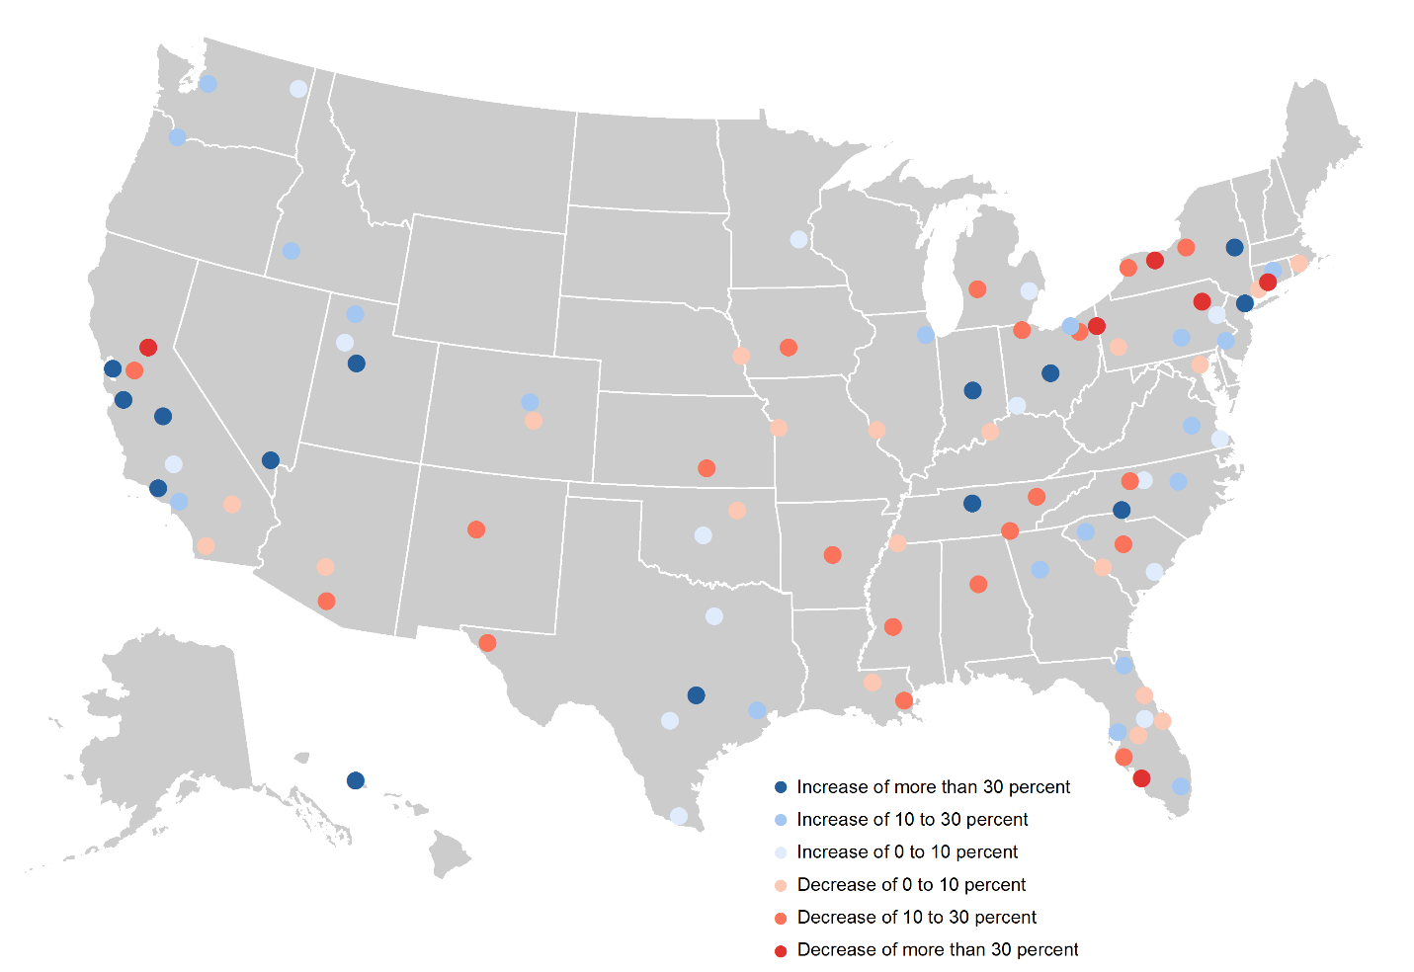
[META HEADER 2: Job density trends across metro areas] Job density trends varied among large metro areas
Figure 4
ANNOTATION:
Although metropolitan America saw a notable increase in job density as a whole, this trend was not widespread across metro areas. Out of 94 large metro areas, only 48 posted increases in perceived job density during the period.
(Keep scrolling)

Slide 12
[META HEADER 2: Job density trends across metro areas] Several sectors of the economy saw widespread increases in job density
Figure 5(A)
ANNOTATION:
Across large metro areas, six sectors of the economy saw widespread increases in perceived job density from 2004 to 2015. For instance, jobs in the health care sector grew denser in 77, or 77 percent, of 94 large metro areas. The perceived density of professional jobs increased in 62 percent of large metro areas.
(Keep scrolling)

Slide 13
[META HEADER 2: Job density trends across metro areas] Several sectors of the economy saw widespread increases in job density
Figure 5(B)
ANNOTATION:
However, in almost every sector, increases in job density fell short of expected ones in most large metro areas. This implies that jobs in most sectors spread disproportionately to less-dense parts of most metro areas from 2004 to 2015, and that the job densification trends seemed to be isolated to a small number of metro areas.
(Keep scrolling)

Slide 14
[META HEADER 2: Job density trends across metro areas] Job density trends varied within metro areas
Figure 6(A)
ANNOTATION:
Looking within metro areas we see a similar pattern—that is, much of the job densification trends seemed to be driven by a small set of already-dense parts of metro areas. While 64 percent of metro areas with core urban counties saw an increase in perceived job density in such counties, just 25 percent of metro areas saw perceived job density increase in their exurban counties.
(Keep scrolling)

Slide 15
[META HEADER 2: Job density trends across metro areas] Job density trends varied within metro areas
Figure 6(B)
ANNOTATION:
Increases in job density however were seldom as great as would be expected. For example, only 30 percent of metro areas with core urban counties saw greater-than-expected increases from 2004 to 2015, indicating that jobs tended to spread out to less-dense parts of these counties.
(Keep scrolling)

Slide 16
[Summary text]
[Transition to Metro dashboard]

Slide 17
[META HEADER 3: Job density trends in each metro] What do job density trends look like in your metro area?
Baltimore-Columbia-Towson, MD

